Slide 1





Capstone
FALCON 9 BOOSTER LANDING SUCCESS PREDICTION
Shahadat Hussain
Researcher, Mechanical Engineering
April, 2024
https://sites.google.com/view/shahadathussain/

Slide 2



OUTLINE
Executive Summary
Introduction
Methodology
Results
Visualization – Charts
Dashboard
Discussion
Findings & Implications
Conclusion
Appendix

Slide 3

EXECUTIVE SUMMARY
Analysis of space mission data reveals a positive trend of improving success rates over time.
Key findings highlight:
Effectiveness of KSC LC-39A as a launch site.
Potential of CCAFS SLC-40 for handling heavier payloads.
Importance of strategic mission planning, evident in consistent success rates in specific orbits.
Observed increase in success rates beyond 2013 reflects advancements in technology and operational practices.
Insights underscore the importance of continuous innovation and collaboration in achieving successful space missions.

Slide 4

INTRODUCTION
The capstone project aims to predict the successful landing of the Falcon 9 first stage.
SpaceX promotes Falcon 9 rocket launches on their website, priced at $62 million, significantly lower than competitors' costs of over $165 million, largely due to the reusable first stage.
Predicting the first stage's landing success enables estimation of launch costs, crucial for competing bids against SpaceX.
Using data science methods, variables like Payload Mass, Flight Number, Orbit Type, Launch Site location, and other factors were examined to gain insights into their behaviors and dependencies, particularly regarding landing success and mission success rates.

Slide 5

METHODOLOGY
Data Collection
APIs
Web scraping using BeautifulSoup library
Data Wrangling
Exploratory Data Analysis
Pandas, matplotlib, numpy, and scipy
SQL
Interactive Visual Analytics
Using Folium map library
Dashboard using Plotly Dash
Prediction Models
SVM
Classification Trees
Regression

Slide 6
DATA COLLECTION THROUGH SPACEX API
Data collection through an API involves retrieving structured data from a remote server using predefined endpoints and protocols.
Key steps include accessing the API, sending a request with parameters specifying the desired data, receiving and parsing the response, and storing the data for further analysis.
APIs provide advantages such as real-time data access, automation of retrieval processes, and interoperability, but users must adhere to terms of use and respect usage limits.
https://github.com/drdataengg/Capstone_Applied_Data_Science_IBM/blob/05b10240338f1652fa38dbd7824a0e0b83e9285c/jupyter-labs-spacex-data-collection-api.ipynb

Slide 7
DATA COLLECTION THROUGH SPACEX API
Request Data
Identify Data Requirement
API Authetic-ation
Initialize Connection
Select Endpoint
Receive Response
Handle Error
Store Data
Check Status Code
Parse Data

Slide 8
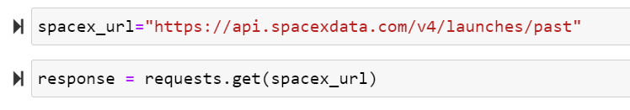
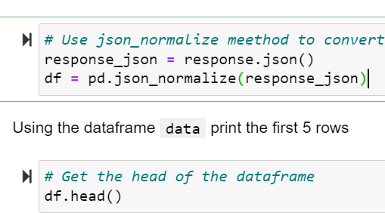
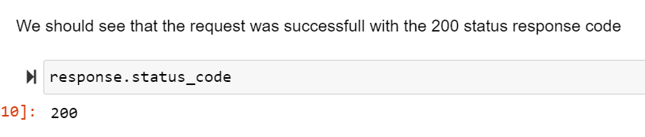
DATA COLLECTION THROUGH SPACEX API

Slide 9
DATA COLLECTION WITH WEB SCRAPING
Web scraping is a method used to automatically extract data from websites.
It involves accessing web pages programmatically, parsing their HTML or other markup languages, and extracting desired information.
Techniques include using libraries or frameworks in programming languages like Python or JavaScript, parsing HTML, automating data collection, and adhering to legal and ethical guidelines.
https://github.com/drdataengg/Capstone_Applied_Data_Science_IBM/blob/05b10240338f1652fa38dbd7824a0e0b83e9285c/jupyter-labs-webscraping.ipynb

Slide 10
DATA COLLECTION WITH WEB SCRAPING
Select Web Scraping Tool
Identify Target Website
Explore Website Structure
Inspect Page Source
Identify Target Data
Extract Data
Write Scraping code
Stored Scraped Data
Parse HTML content
Send HTTP request

Slide 11
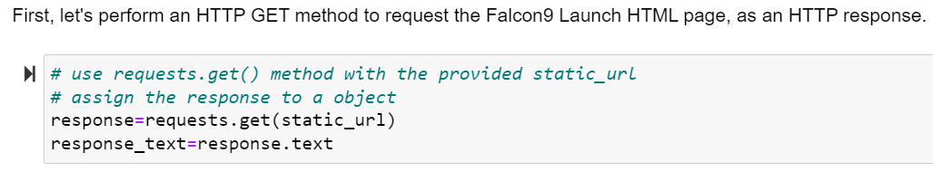
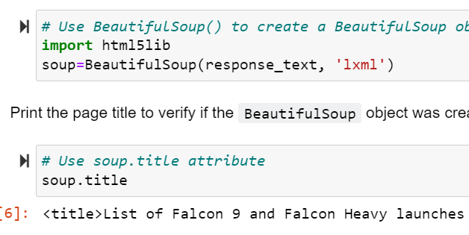
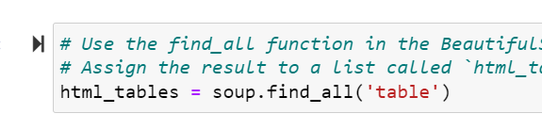
DATA COLLECTION WITH WEB SCRAPING

Slide 12
DATA WRANGLING
Data wrangling, also known as data munging, involves cleaning, transforming, and preparing raw data for analysis.
It encompasses steps such as data collection, cleaning, transformation, integration, feature engineering, and data splitting.
Data wrangling ensures that the data is accurate, complete, and structured in a way that facilitates meaningful analysis and modeling.
https://github.com/drdataengg/Capstone_Applied_Data_Science_IBM/blob/05b10240338f1652fa38dbd7824a0e0b83e9285c/labs-jupyter-spacex-Data%20wrangling.ipynb

Slide 13
DATA WRANGLING
Data Cleaning
Data Discovery
Data Structuring
Data Enriching
Data Validating
Data Publishing

Slide 14
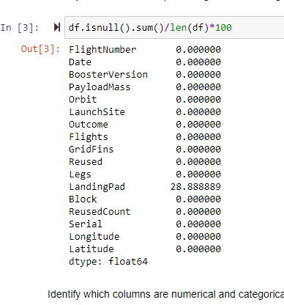
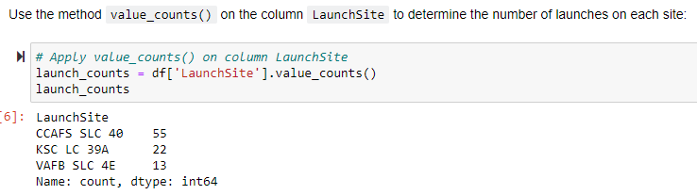
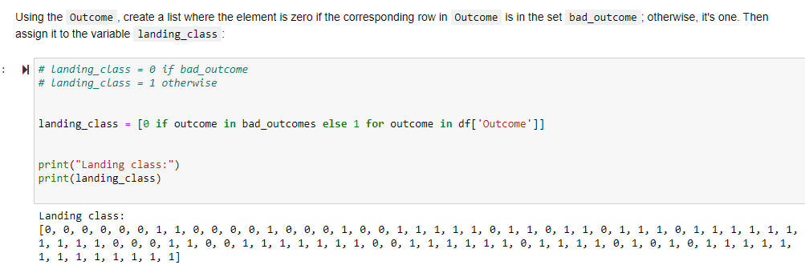
DATA WRANGLING

Slide 15
EDA WITH DATA VISUALIZATION
Exploratory data analysis was conducted on the extracted SpaceX data to uncover patterns. Key libraries including pandas (for data manipulation), matplotlib (a versatile plotting library), seaborn (a visualization library built on matplotlib), and numpy (for array support) were imported.
Generated multiple plots to explore the dataset:
Categorical plots comparing payload mass with flight number.
Scatterplots depicting the relationship between payload mass and launch site.
Scatterplots showing orbit versus flight number and orbit versus payload mass.
Created a line plot to visualize the yearly launch success rate.
https://github.com/drdataengg/Capstone_Applied_Data_Science_IBM/blob/05b10240338f1652fa38dbd7824a0e0b83e9285c/jupyter-labs-eda-dataviz.ipynb.jupyterlite.ipynb

Slide 16
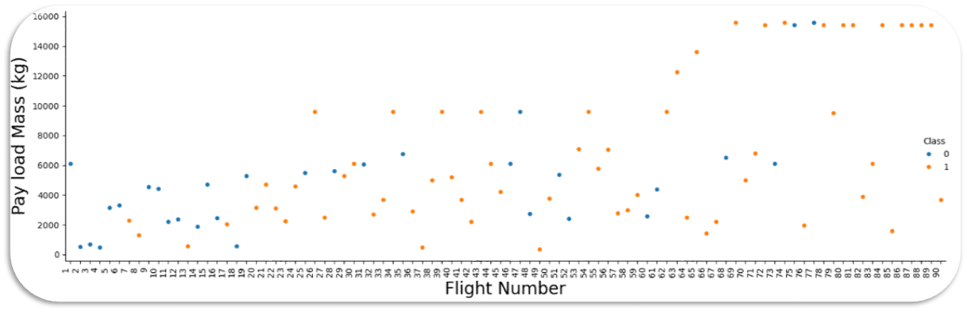
PAYLOAD MASS VS FLIGHT NUMBER

Slide 17
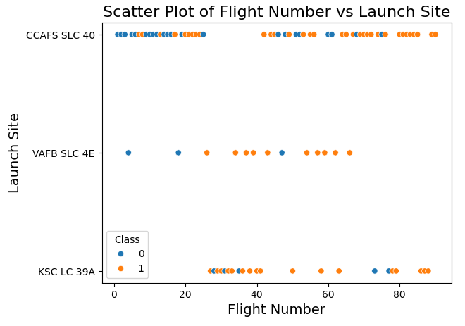
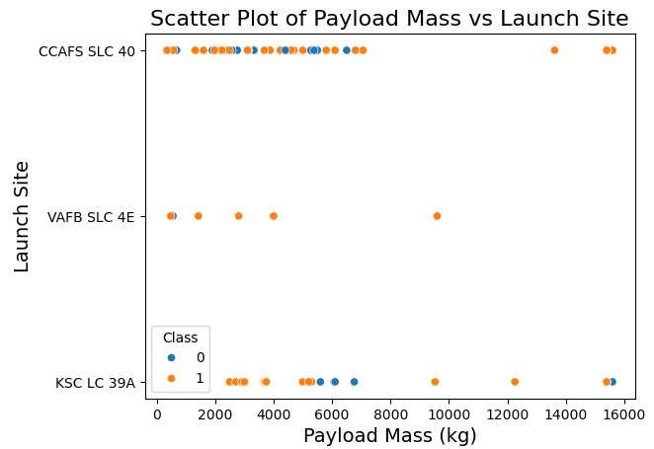
LAUNCH SITE VS FLIGHT NUMBER AND PAYLOAD MASS

Slide 18
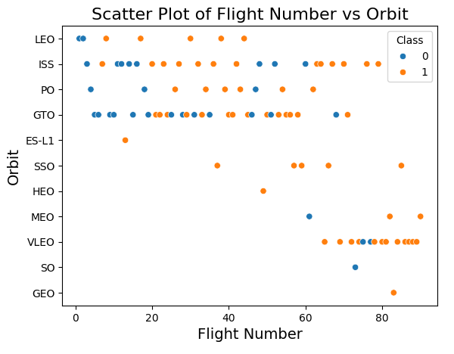
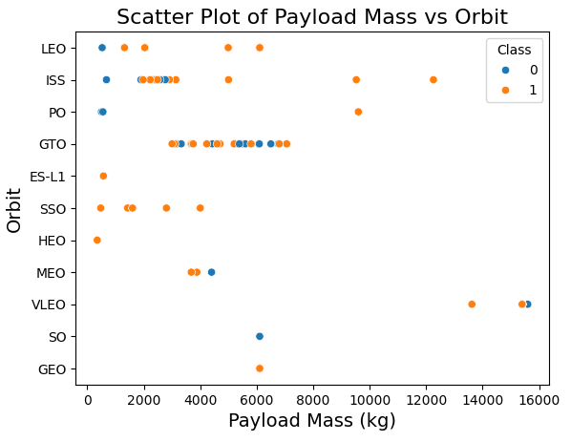
ORBIT TYPE VS FLIGHT NUMBER AND PAYLOAD MASS

Slide 19
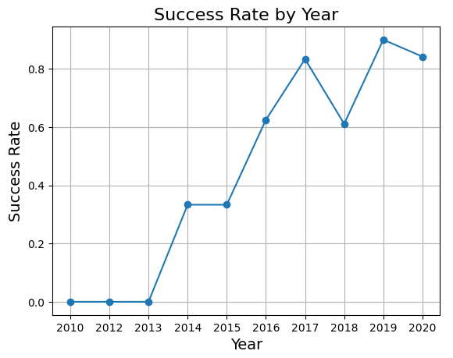
YEARLY SUCCESS RATE

Slide 20
EDA WITH SQL
Exploratory Data Analysis (EDA) with SQL involves querying a database to explore and analyze datasets directly. This includes describing the data, sampling, handling missing values, exploring relationships, identifying patterns, and, while not its primary function, some basic visualization capabilities. EDA with SQL is an efficient way to gain insights into large datasets within the database environment.
Conducted EDA with SQL on SpaceX dataset.
Tasks included showcasing unique launch site names and retrieving records with specific launch site strings.
Calculated total payload mass for NASA's CRS program and average payload mass for booster version F9 v1.1.
Identified date of first successful ground pad landing outcome.
Listed boosters with successful drone ship landings within specified payload mass range.
Tabulated total successful and failed mission outcomes.
Identified booster versions with maximum payload mass using subquery.
Compiled records to display month names, failure landing outcomes, booster versions, and launch sites for 2015.
Ranked count of landing outcomes between specified dates.

Slide 21
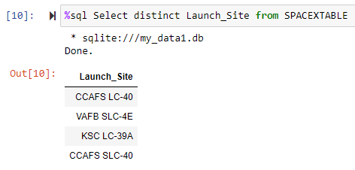
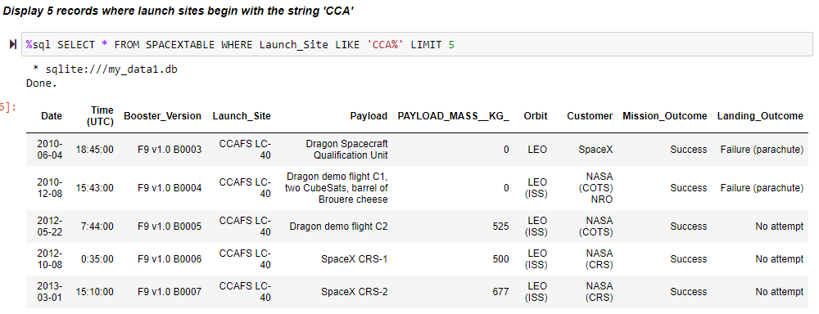
EDA WITH SQL
https://github.com/drdataengg/Capstone_Applied_Data_Science_IBM/blob/d2e55cc601f0090e851ec66aeb9cce954f0962d5/jupyter-labs-eda-sql-coursera_sqllite.ipynb

Slide 22
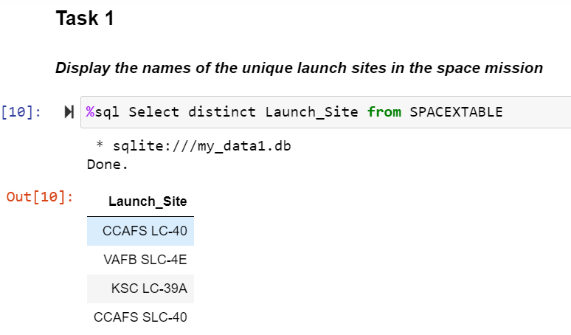
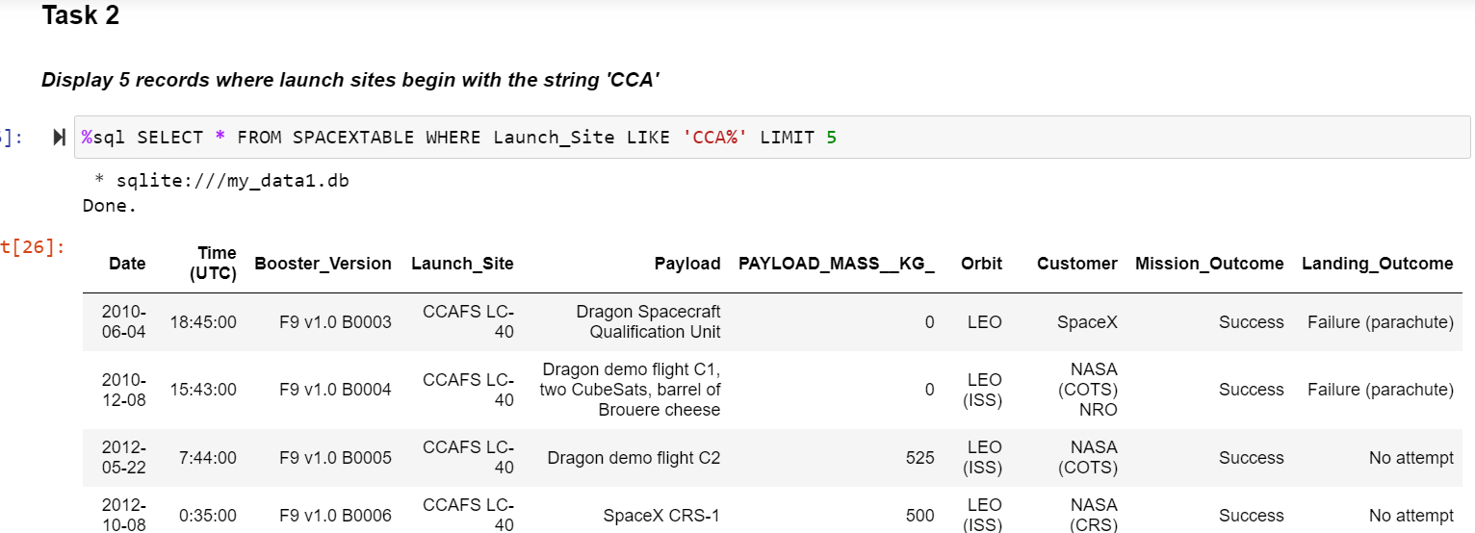
EDA WITH SQL

Slide 23
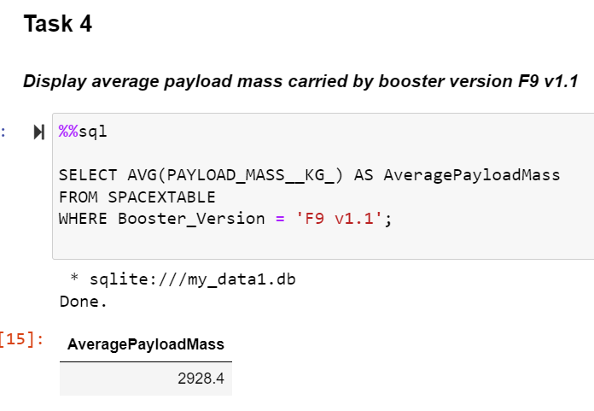
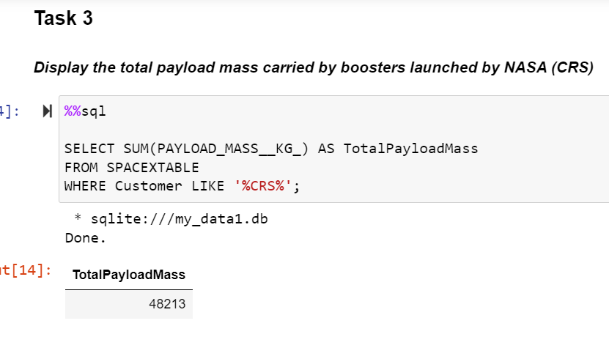
EDA WITH SQL

Slide 24
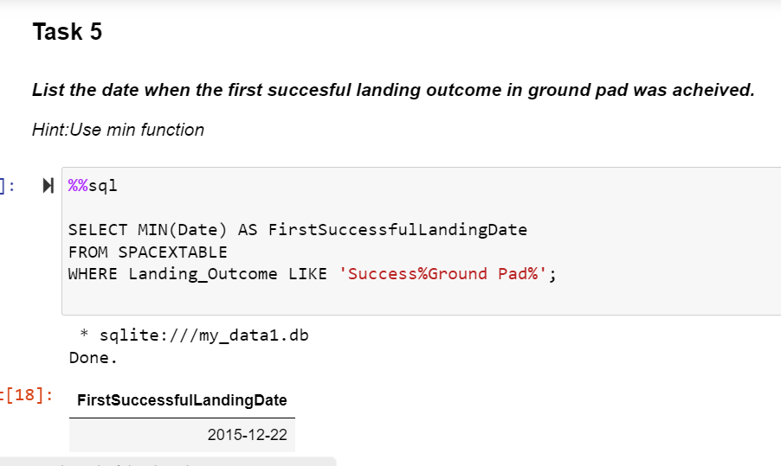
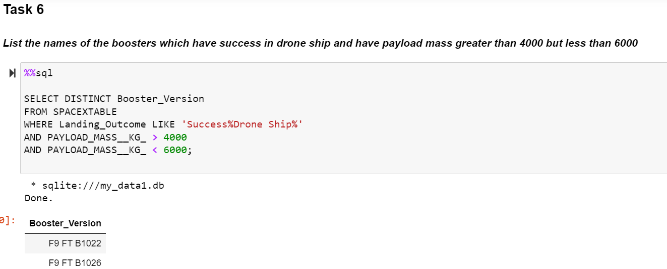
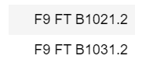
EDA WITH SQL

Slide 25
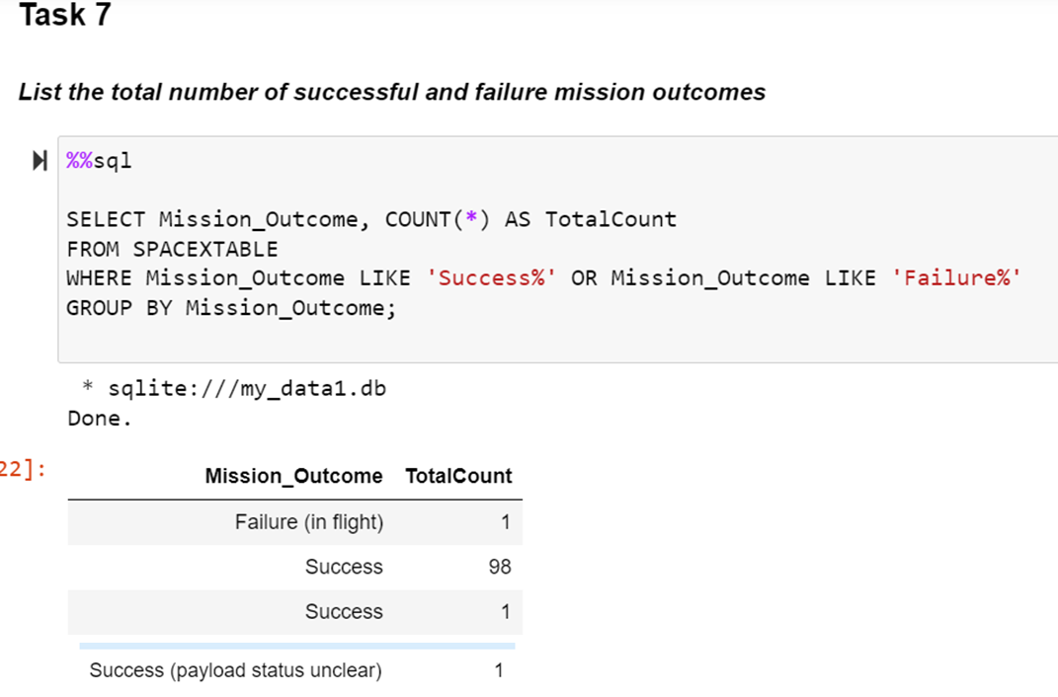
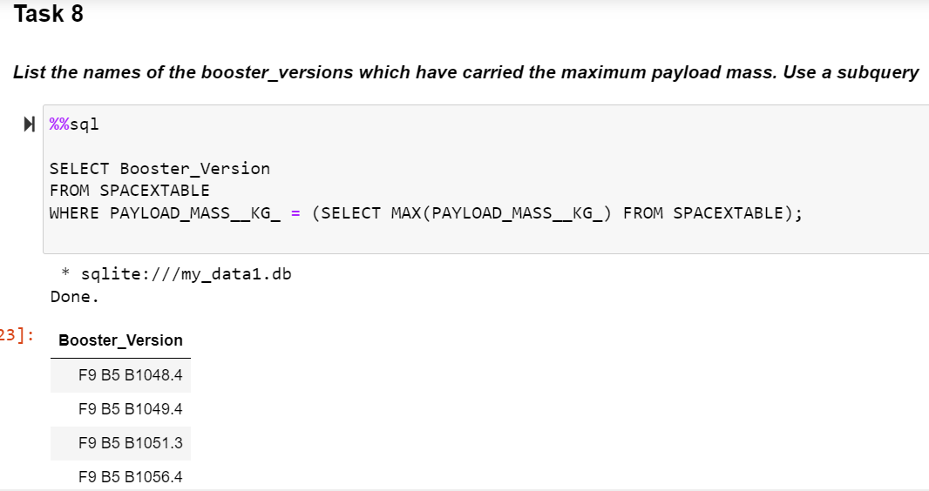
EDA WITH SQL

Slide 26
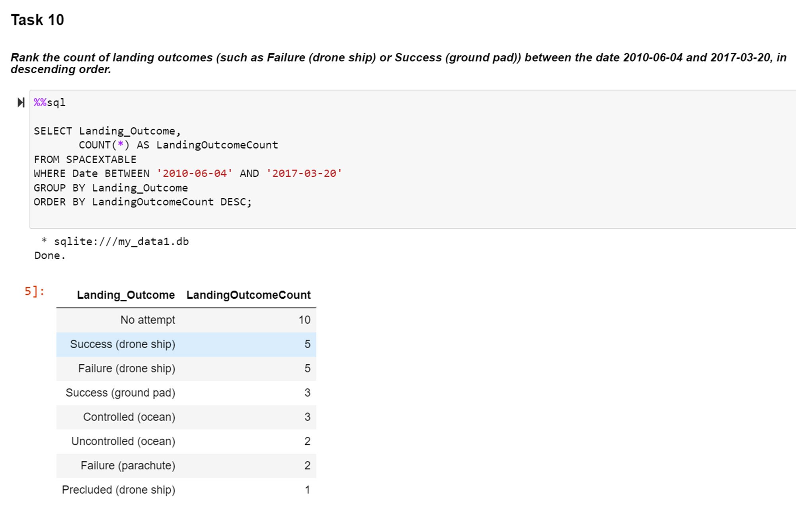
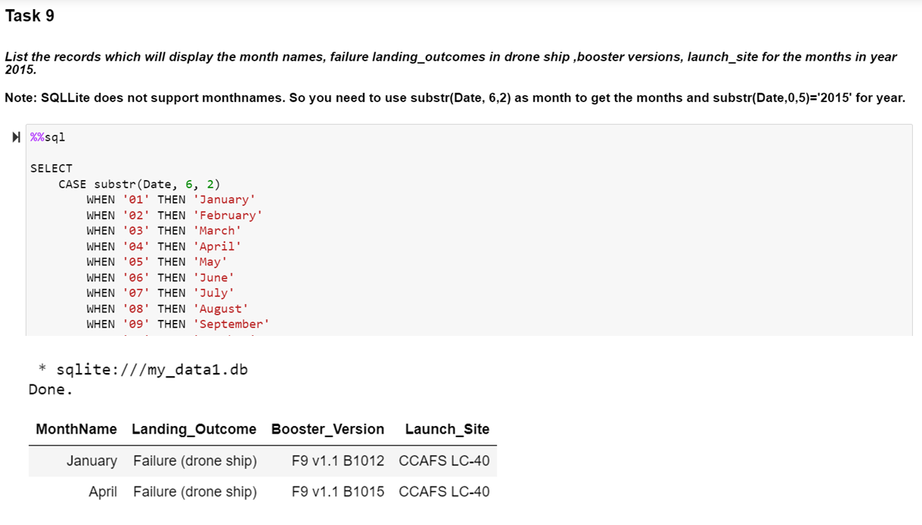
EDA WITH SQL

Slide 27
INTERACTIVE VISUAL ANALYTICS: FOLIUM MAP
Folium enables interactive visual analytics in Python by creating dynamic maps for geospatial data exploration. Users can plot data points, customize map styles, and interact with map elements like markers and polygons. Integration of visualizations and widgets allows for deeper insights into spatial patterns and relationships, enhancing geospatial data analysis.
Using Folium maps, the following actions were performed to discover geographical patterns related to launch sites:
Marking all launch sites on a map.
Indicating the success or failure of launches for each site on the map.
Calculating the distances between a launch site and its proximities.
https://github.com/drdataengg/Capstone_Applied_Data_Science_IBM/blob/d2e55cc601f0090e851ec66aeb9cce954f0962d5/lab_jupyter_launch_site_location%20(1).ipynb

Slide 28
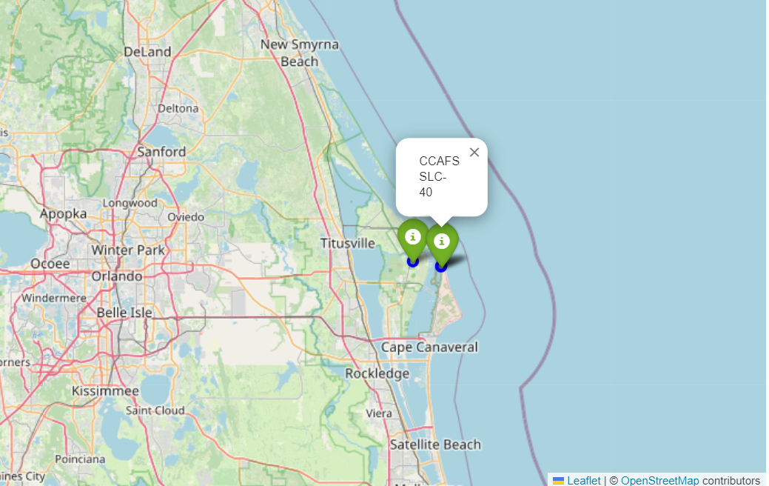
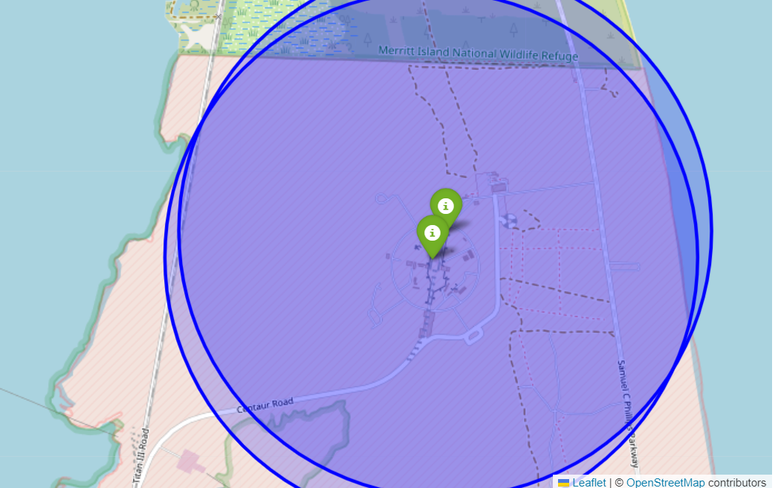
LAUNCH SITES MARKED WITH MARKERS AND CIRCLE

Slide 29
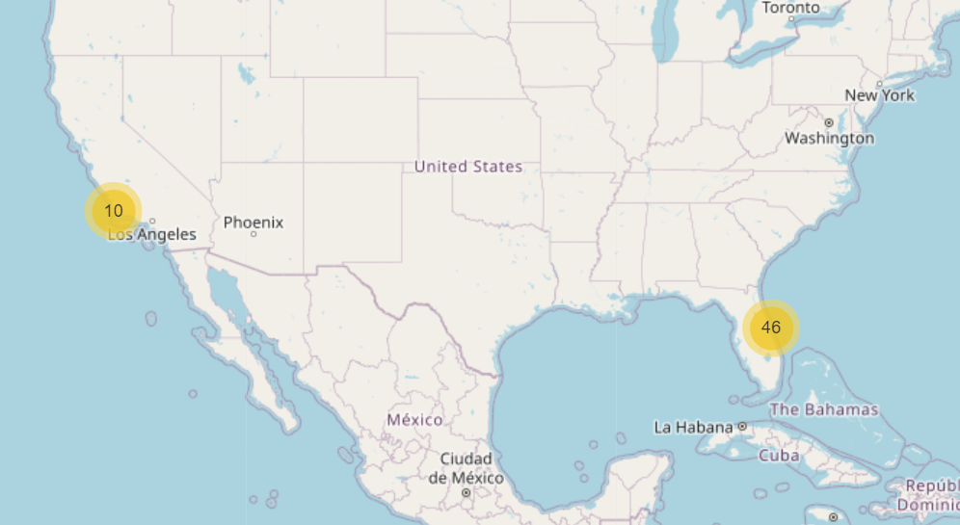
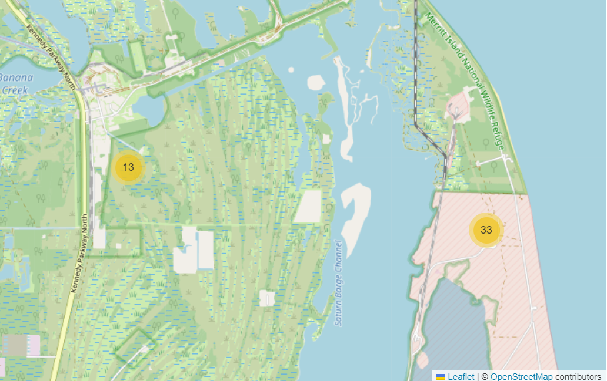
TOTAL NUMBER OF LAUNCHES PER SITE

Slide 30
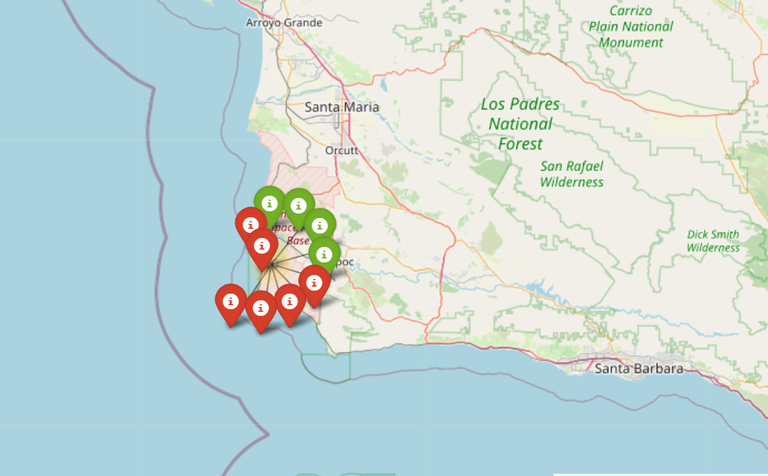
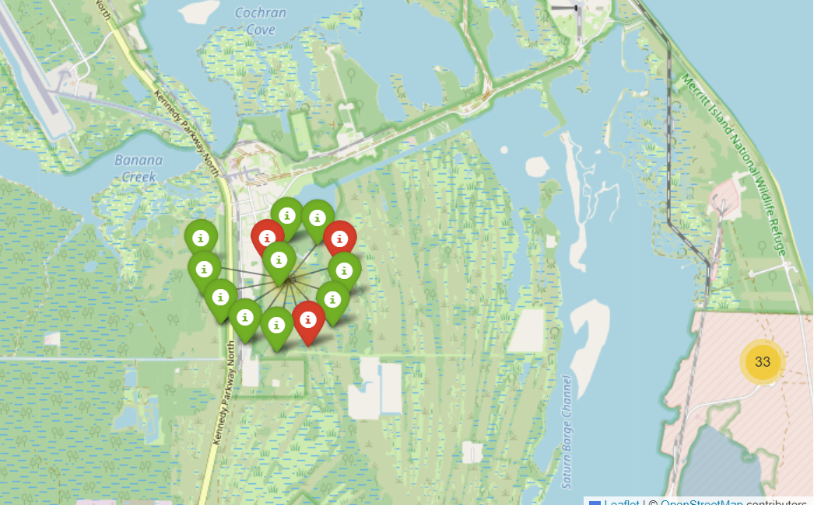
SUCCESSFUL AND FAILED LAUNCHED MARKED WITH MARKER OF DIFFERENT COLORS

Slide 31
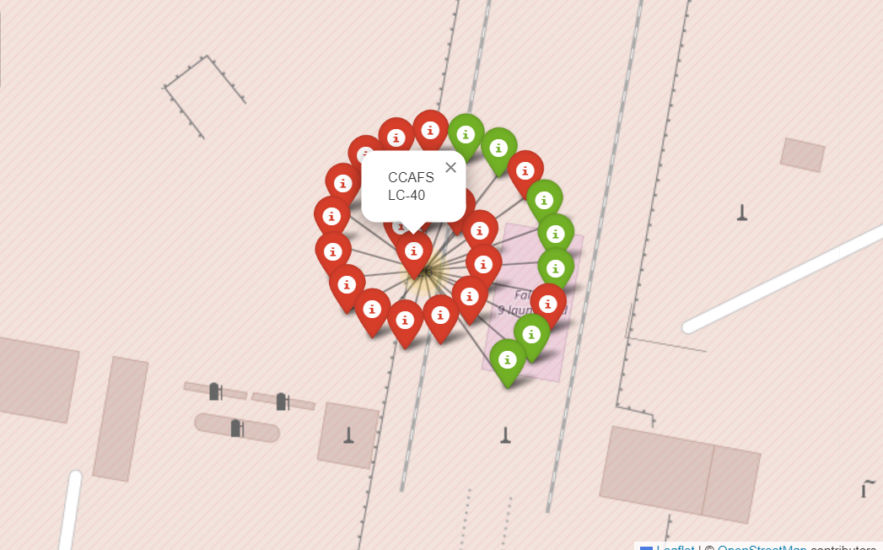
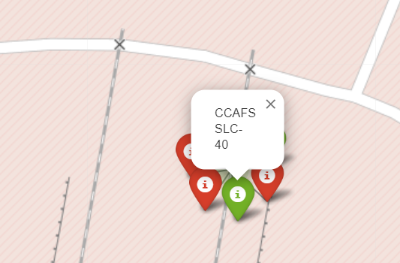
SUCCESSFUL AND FAILED LAUNCHED MARKED WITH MARKER OF DIFFERENT COLORS AND POPUP LABELS WITH LAUNCH SITE NAME

Slide 32
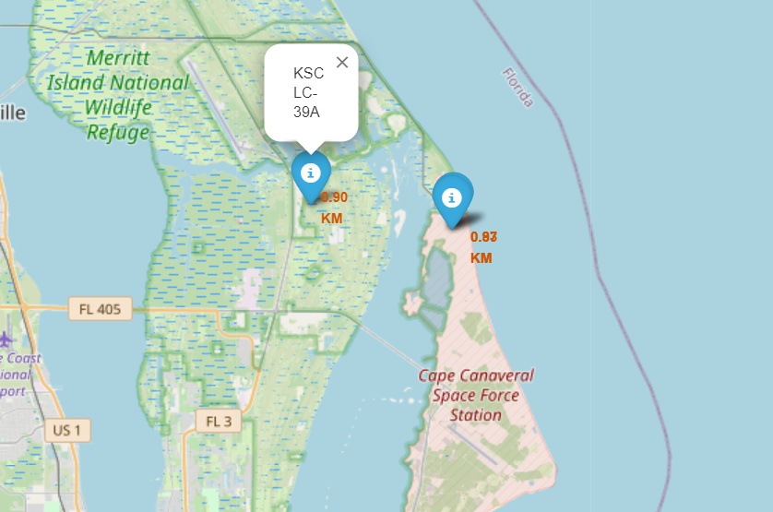
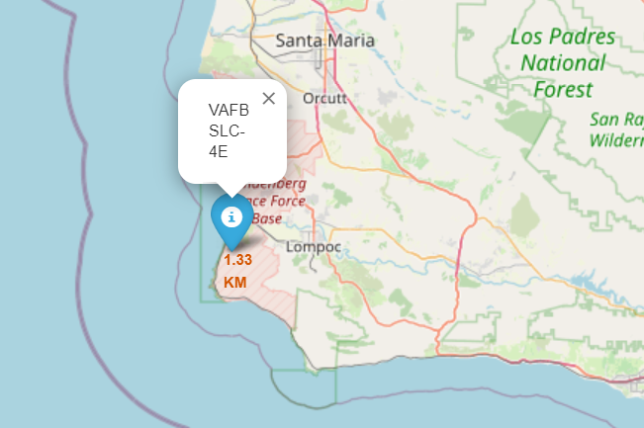
DISTANCE BETWEEN LAUNCH SITES AND NEAREST COASTLINE

Slide 33
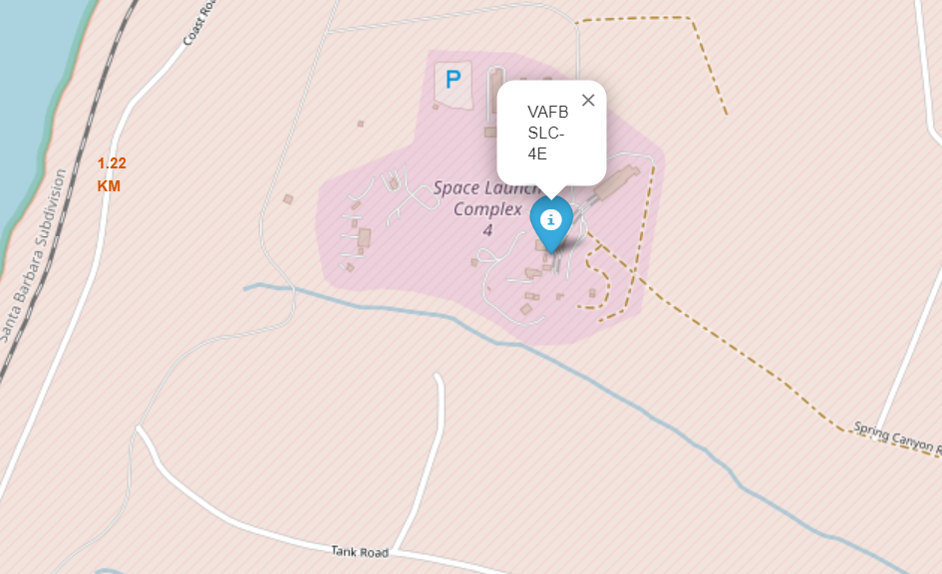
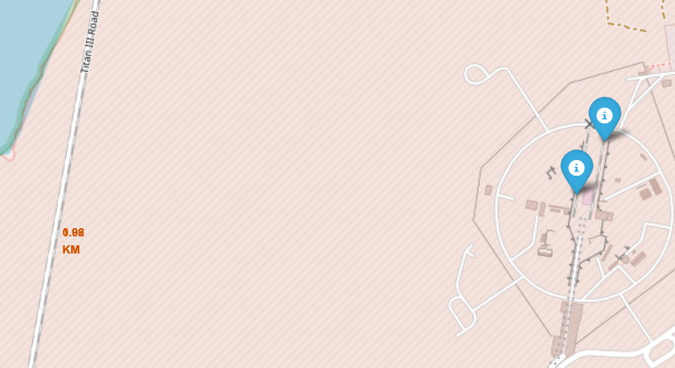
DISTANCE BETWEEN LAUNCH SITES AND NEAREST RAILWAY

Slide 34
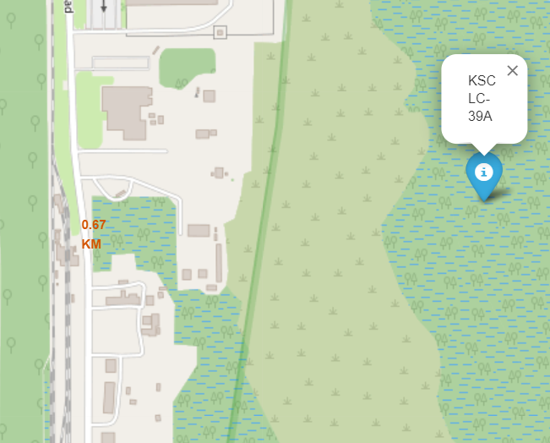
DISTANCE BETWEEN LAUNCH SITES AND NEAREST HIGHWAY

Slide 35
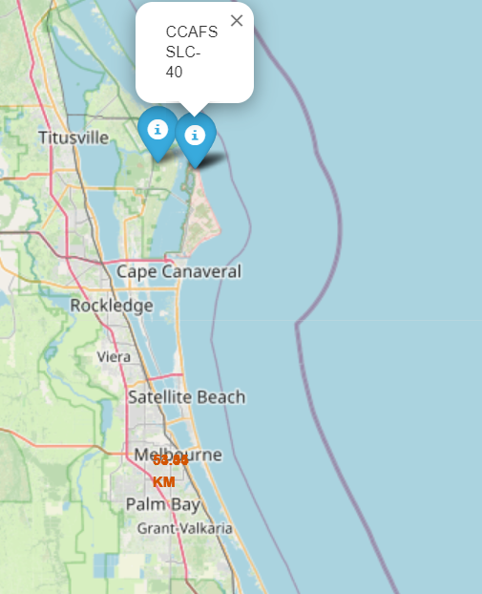
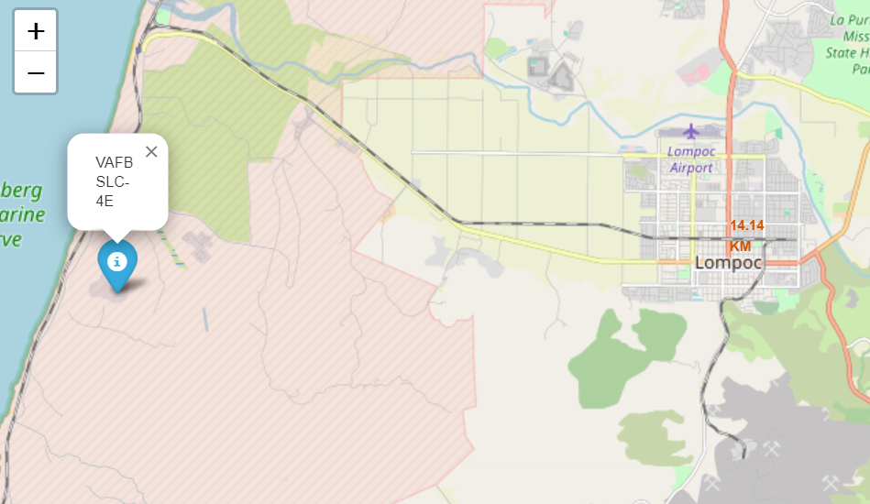
DISTANCE BETWEEN LAUNCH SITES AND NEAREST CITY AREA

Slide 36
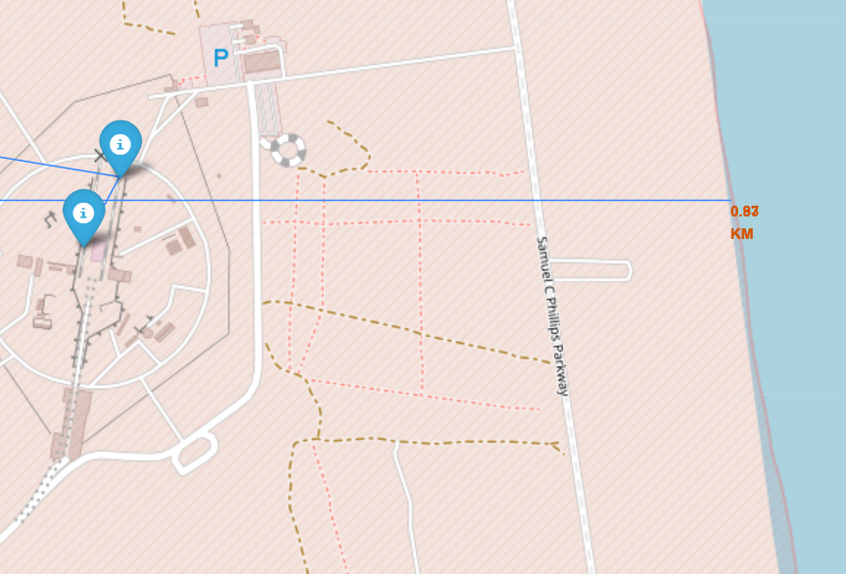
DISTANCE BETWEEN LAUNCH SITES AND NEAREST COAST WITH POLYLINE

Slide 37
INTERACTIVE VISUAL ANALYTICS: PLOTLY DASH
Dash and Plotly Express empower users to create interactive web-based dashboards in Python without the need for additional web development skills. These dashboards feature interactive components like dropdowns and sliders, responsive layouts, and customizable styling.
A Plotly Dash application was created for interactive visual analytics on real-time SpaceX launch data.
Input components like a dropdown list and range slider were included to interact with visualizations.
Tasks involved adding a launch site dropdown and range slider, and implementing callback functions for rendering pie and scatter plots.
The dashboard enables users to explore SpaceX launch data dynamically through interactive elements.
The tasks guided participants through building various components of the dashboard for comprehensive data analysis.
https://github.com/drdataengg/Capstone_Applied_Data_Science_IBM/blob/082882e665b1711d0e0ac46fcc36b2a4bf52a37c/spacex_dash_app.py

Slide 38
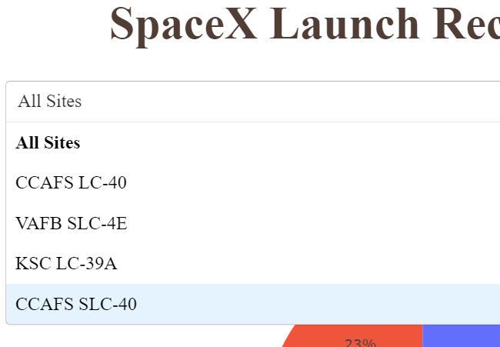
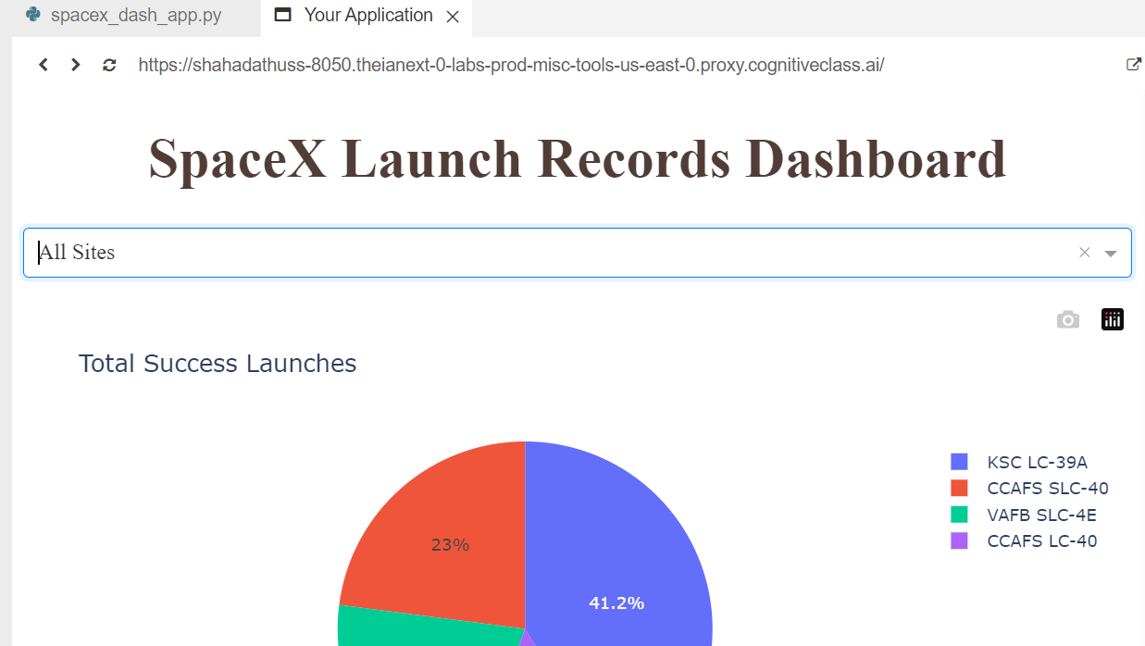
DASHBOARD TAB 1

Slide 39
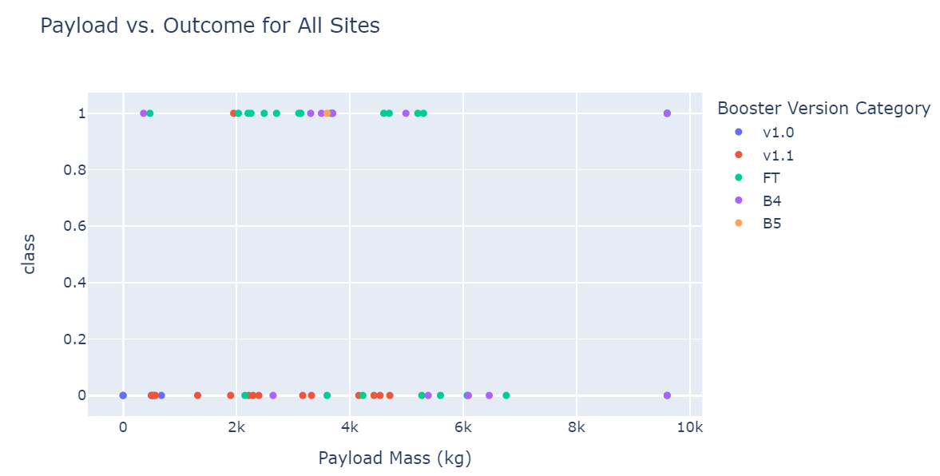
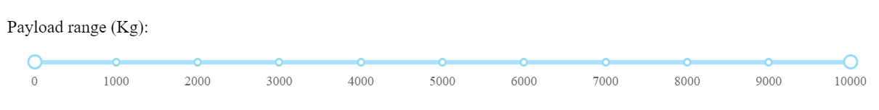
DASHBOARD TAB 2
Payload Range Slider

Slide 40
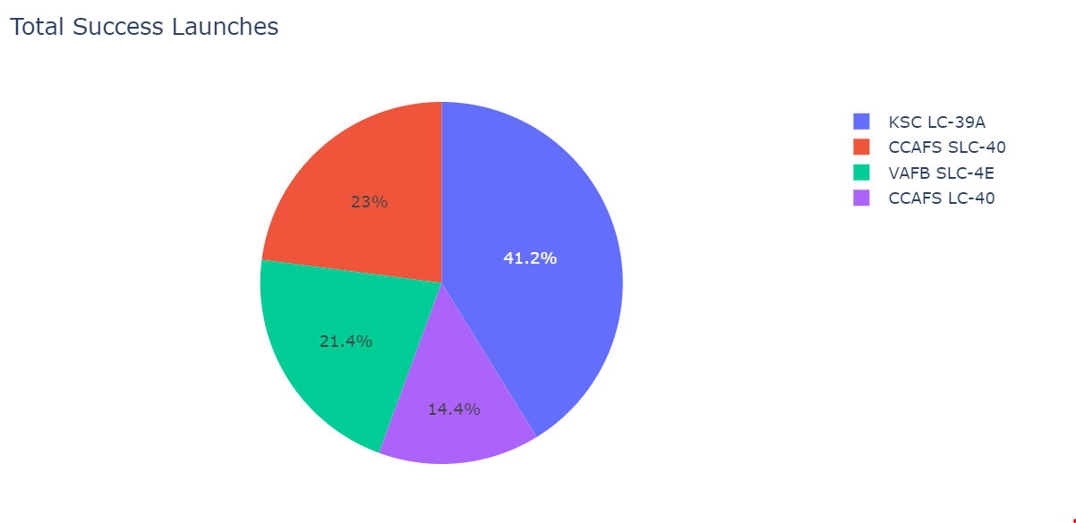
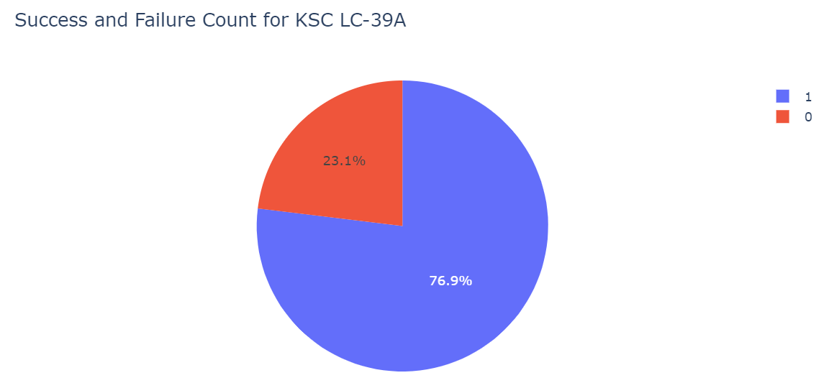
DASHBOARD TAB 3
Launch Site with highest landing success

Slide 41
MACHINE LEARNING PREDICTION MODELS
Machine learning prediction models utilize historical data to identify patterns and make predictions about future outcomes or classify new data points. They are applied across diverse domains for tasks like stock price forecasting, customer behavior prediction, disease diagnosis, and more. These models encompass various types, including regression, classification, clustering, and deep learning models, tailored to different data and tasks.
The following tasks were completed:
Conducted exploratory data analysis to determine training labels.
Established a column for the class.
Standardized the data.
Partitioned the dataset into training and test data.
Identified the optimal hyperparameters for Support Vector Machines, Classification Trees, and Logistic Regression.
Evaluated the performance of each method using the test dataset.
https://github.com/drdataengg/Capstone_Applied_Data_Science_IBM/blob/aa627719d92ad8815b40dd5a4f9eb4e10fbac2d3/SpaceX_Machine%20Learning%20Prediction_Part_5%20(1).ipynb

Slide 42

LOGISTIC REGRESSION ALGORITHM

Slide 43

LOGISTIC REGRESSION CONFUSION MATRIX

Slide 44

SVM ALGORITHM

Slide 45

SVM CONFUSION MATRIX

Slide 46

DECISION TREE ALGORITHM

Slide 47

DECISION TREE CONFUSION MATRIX

Slide 48

KNEIGHBORS ALGORITHM

Slide 49

KNEIGHBORS CONFUSION MATRIX

Slide 50

BEST PERFORMING ALGORITHMS

Slide 51
DISCUSSION
Increasing flight numbers tend to correlate with a higher rate of successful landings, indicating a potential continuous learning process among engineers involved in the project, building on previous results.
The success rate at each launch site tends to increase as the flight number increases, suggesting a learning curve and improvement in processes over time.
KSC LC 39A exhibits the highest success rate among all launch sites.
The majority of payload masses sent are below 7000 kg.
For payloads exceeding 12000 kg, CCAFS SLC-40 demonstrates a better success rate compared to other launch sites.
SSO orbit shows a 100% success rate, with LEO orbit also demonstrating higher success rates.
Beyond 2013, there is an observed increase in success rate with each passing year.
All four launch sites are situated closer to the coastline, railway, and highway, while being farther from urban areas. This placement ensures safety in case of failure, as launch sites are kept away from densely populated areas. Additionally, proximity to the coast, railway, and highway provides logistical advantages for transportation of heavy rocket or payload objects.

Slide 52
OVERALL FINDINGS & IMPLICATIONS
Findings
The success rates at each launch site tend to improve with increasing flight numbers, reflecting a learning curve and refinement of processes.
Beyond 2013, there is a notable increase in success rates, indicating advancements in technology and operational practices.
The strategic positioning of launch sites away from urban areas, closer to the coastline, railway, and highway, ensures public safety in the event of failure and facilitates efficient logistics for transporting heavy payloads.
Implications
The findings suggest that the aerospace industry is evolving, with a focus on continuous improvement and learning from past experiences.
The observed increase in success rates over time underscores the importance of ongoing research, development, and collaboration within the space exploration community.
The strategic placement of launch sites highlights the significance of safety considerations and logistical efficiency in mission planning and execution.

Slide 53

CONCLUSION
The analysis indicates a positive trend of improving success rates in space missions, driven by continuous learning and refinement of engineering practices.
KSC LC 39A emerges as an effective launch site, while CCAFS SLC-40 shows promise for handling heavier payloads.
Consistent success rates in specific orbits highlight the significance of strategic mission planning.
The observed increase in success rates beyond 2013 reflects advancements in technology and operational practices, emphasizing the dynamic nature of the aerospace industry.

Slide 54

APPENDIX
Calculation of distance between launch sites and other points of interests

Slide 55
APPENDIX
 | Launch Site | Total No. of Launches | Successful Landing of First Stage
1 | CCAFS LC-40 | 26 | 7
2 | CCAFS SLC-40 | 7 | 3
3 | KSC LC-39A | 13 | 10
4 | VAFB SLC-4E | 10 | 4

